Slide 1
Provide Insights to the Marketing Team in Food & Beverage Industry
CodeX is a German beverage company that is aiming to make its mark in the Indian market. A few months ago, they launched their energy drink in 10 cities in India.
Their Marketing team is responsible for increasing brand awareness, market share, and product development. They conducted a survey in 10 cities and received results from 10k Customers.
They want analyse their survey results to meaningful insights.

Slide 2
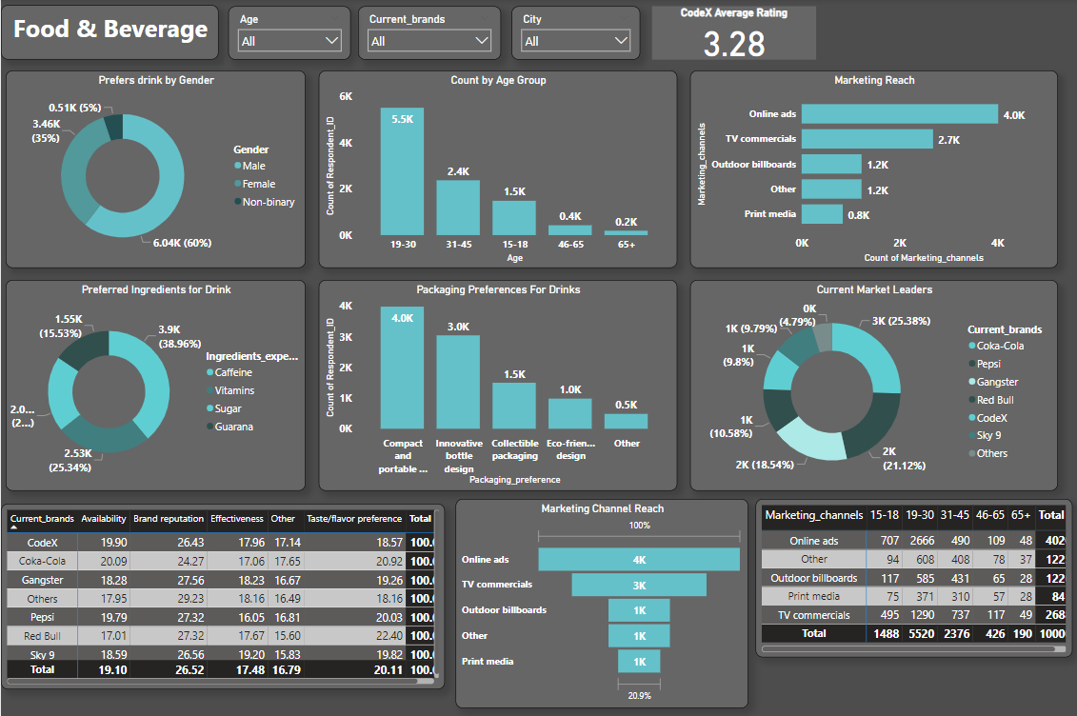

Slide 3
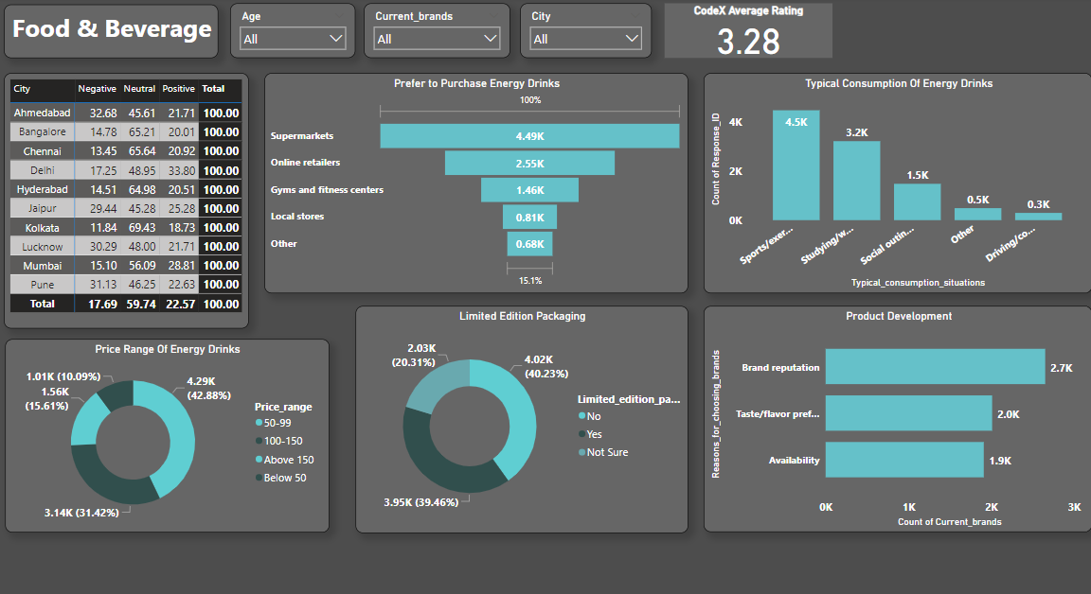

Slide 4
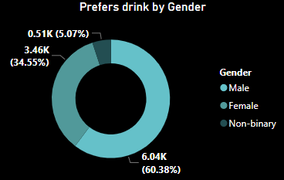
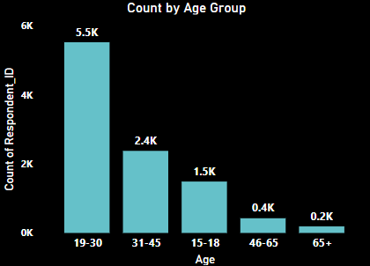
Demographic Insights
1) Who prefers energy drink more? (male/female/non-binary?)
Out of 10 thousand customers, the number of male customers is 6038.
This shows 60% of the consumers are male who prefer energy drinks more.
2) Which age group prefers energy drinks more?
From the bar chart we know that energy drinks are more popular among youngsters. More than 50% of the customers belong to the Age Group 19-30.
If we look overall young age groups from 15 to 30, then the % of customers will 70%.

Slide 5
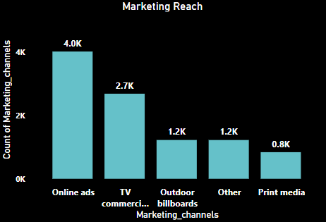
Which type of marketing reaches the most Youth (15-30)?
Online Ads are the most effective marketing channel that reached Age group in between 15-30.

Slide 6
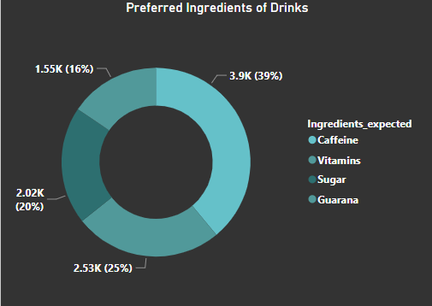
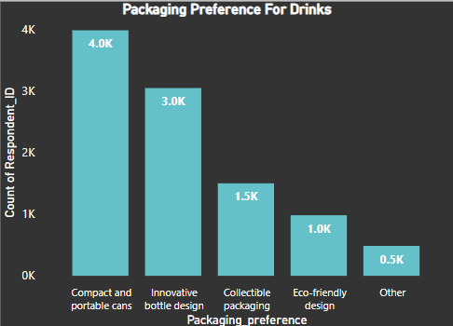
Consumer Preferences
What are the preferred ingredients of energy drinks among respondents?
As we know caffeine increases activity in your brain and nervous system and it’s used in energy drinks.
Caffeine is the most preferred ingredient followed by the Vitamins in energy drinks.
2) What packaging preferences do respondents have for energy drinks?
Compact & Portable Cans are high in demand followed by Innovative Bottle Designs.

Slide 7
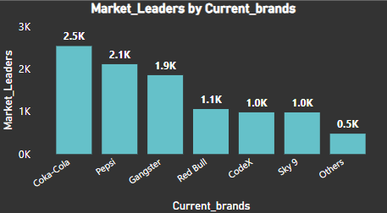
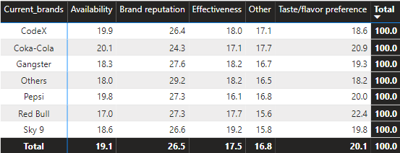
Competition Analysis:
Who are the current market leaders?
Coka Cola is current market leader followed by Pepsi.
The data shows there more customers for Coka Cola than the other brands.
What are the primary reasons consumers prefer those brands over ours?
The primary reason reason for choosing the brands by consumers is brand reputation.

Slide 8
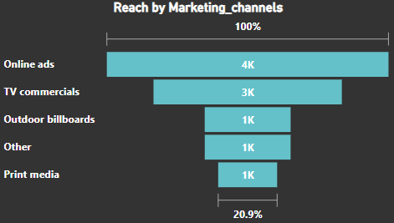
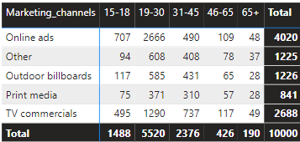
Marketing Channels and Brand Awareness
Which marketing channel can be used to reach more customers?
Online Ads is a marketing channel can be used reach more customers.
How effective are different marketing strategies and channels in reaching our customers?
Online Ads is a more effective marketing channels to reach our customers followed by TV commercials .

Slide 9
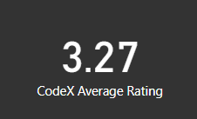
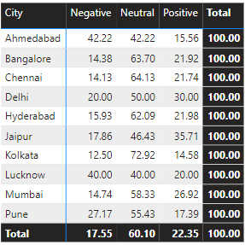
Brand Penetration
What do people think about our brand? (overall rating)
The Avg. rating of our brand is 3.27
Which cities do we need to focus more on?
We need to focus more in city like Ahmedabad Kolkata Lucknow Pune because most negative response for our brand is in these city.

Slide 10
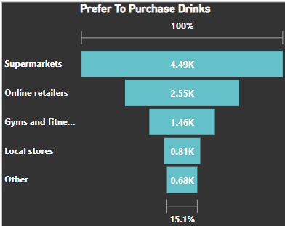
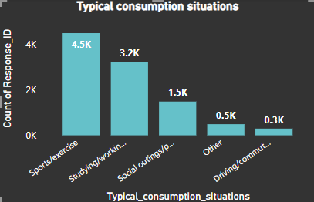
Purchase Behavior
Where do respondents prefer to purchase energy drinks?
Supermarkets are the most common choice of customers to buy energy drinks.
2) What are the typical consumption situations for energy drinks among respondents?
Sports and exercise are the most typical consumption situations for energy drinks among customers.

Slide 11
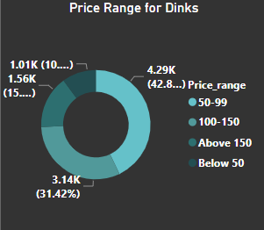
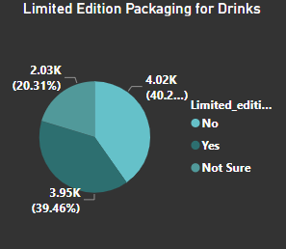
What factors influence respondents' purchase decisions, such as price range and limited edition packaging?
42.8% of the customers buy a product if the price is between 50-99.
40% of the customers do not expect a change in the packaging while 39% of customers are ready to trying the Limited Edition Packaging.

Slide 12
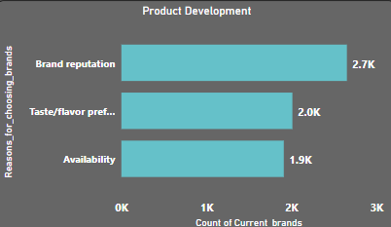
Product Development
Which area of business should we focus more on our product development? (Branding/taste/availability)
For product development we need to work on the availability of the product.

Slide 13
Market Research Based Question
Recommendations For CodeX
1) What immediate improvements can we bring to the product?
» Need to improve Availability and Taste.
» Most of the customers want Limited edition packaging.
» We want to improve product then we need to reduced sugar content and add more natural ingredients.
» Most customers is interested in natural and organic flavors.
» Improve positive response rate
2) What should be the ideal price of our product?
» Ideal price for our product in between 50 to 150.
» Because customers who lives in Ahmedabad, Bangalore, Chennai, Hyderabad, Jaipur, Mumbai, Pune they preferred price in between 50 To 99.
» While in the rest of the cities people ready to pay up to 150.

Slide 14
3) What kind of marketing campaigns we can run?
» We can use Online ads as marketing campaigns. Because
» We have seen in the insights that our customers fall in the age group of 15 to 30.
» This age group people is very much active on social media.
» They get know about our product from online ads.
4) What kind of offers, and discounts we can run?
» As we saw in the last insights different cities have different price range if our pricing offer does not go with brand strategy .
» Then we can offer pack of 6 energy drink cans in cheaper cost.
» Also As we know in each cities celebrates multiple festivals throughout year.
» So we can give Discounts or multiple offer just like buy 2 get 1 free OR buy 2 can and win gift.

Slide 15
5)Who can be a brand ambassador, and why?
» We know that energy drink is consumed by who do some physical activity so we can choose our ambassador is sportsperson or athlete
» We should choose Sunil chhetri and ms dhoni
» As we know Sunil chhetri is physically fit as a footballer and nowadays he is very famous indian footballer he has a good reach on social media in last two year he win the tournaments as a indian caption that's why most of youth fallow him.
» We know the craze of ms dhoni in youth Even after his retirement, his picture of playing Candy Crush made it the most trending topic for days and millions of new users downloaded the game after that. This is the impact of MS Dhoni.
6) Who should be our target audience, and why?
» We have seen in the insights that our customers fall in the age group of 15 to 30.
» From the data the count show 66% of the drink consumers as youth that's why we should target age group 15 TO 30

